Slide 1
American Legion Auxiliary Legislative Program
Midwinter Convention
Oacoma, February 21, 2026
Micheline Nelson
SD Department Legislative Chairman

Slide 2
Purpose of American Legion Auxiliary Legislative Committee
The purpose of the Legislative Committee is to provide information and assistance to American Legion Auxiliary members to advocate for the legislative agenda of The American Legion.
The Legislative program provides information and assistance to American Legion Auxiliary members to advocate for the legislative agenda of The American Legion.
American Legion Auxiliary Advocacy Guide is found at www.legion-aux.org. Log into national website and once in members section click on “Guides”.
Click on Legislative Advocacy Guide

Slide 3

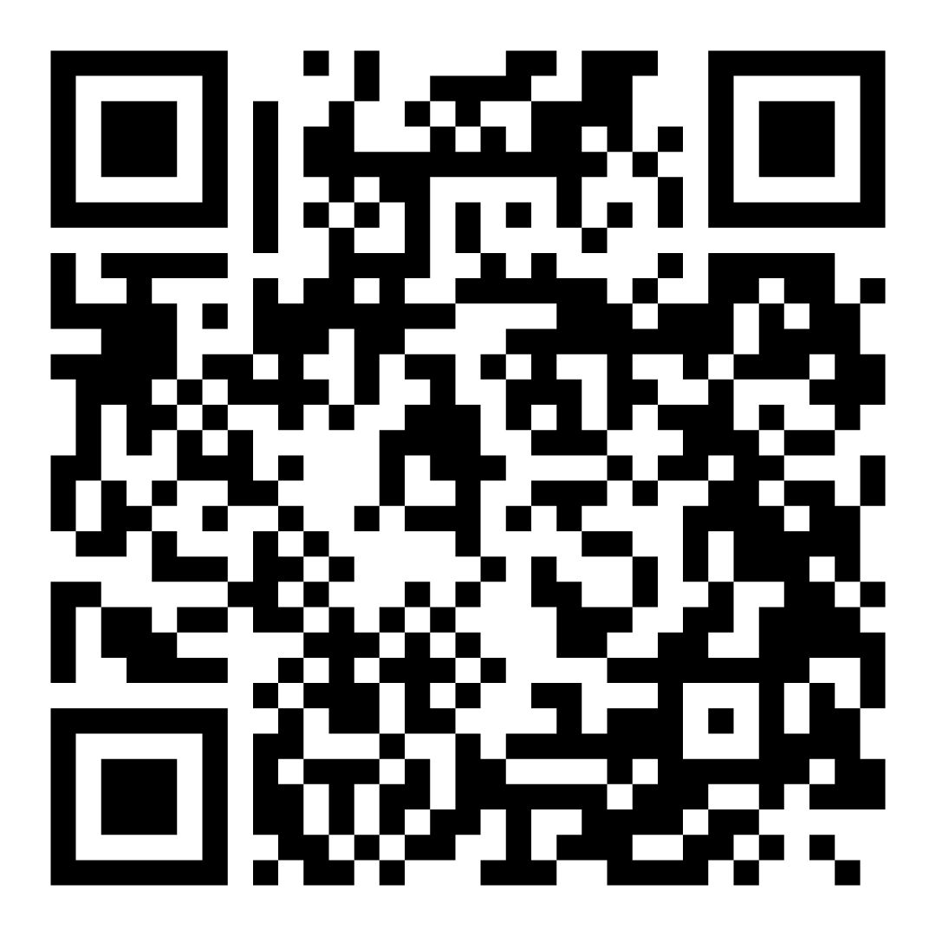
Did you create your member account on the national ALA website?
Scan this QR code

Slide 4
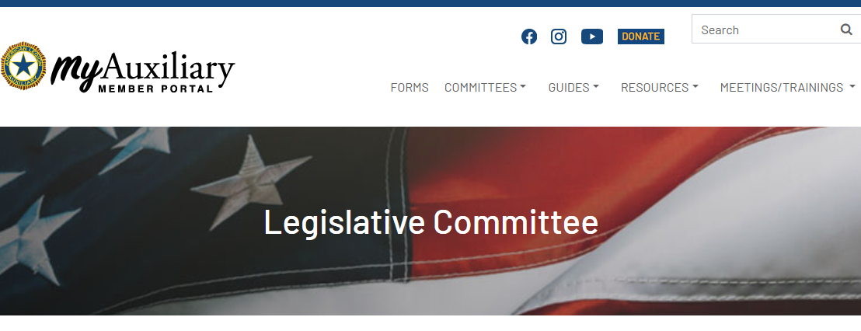
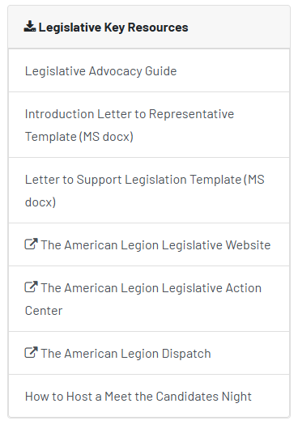

Ideas to Get Involved
https://member.legion-aux.org/member/committees/legislative
Find resources
Legislative_Advocacy_Guide.pdf

Slide 5
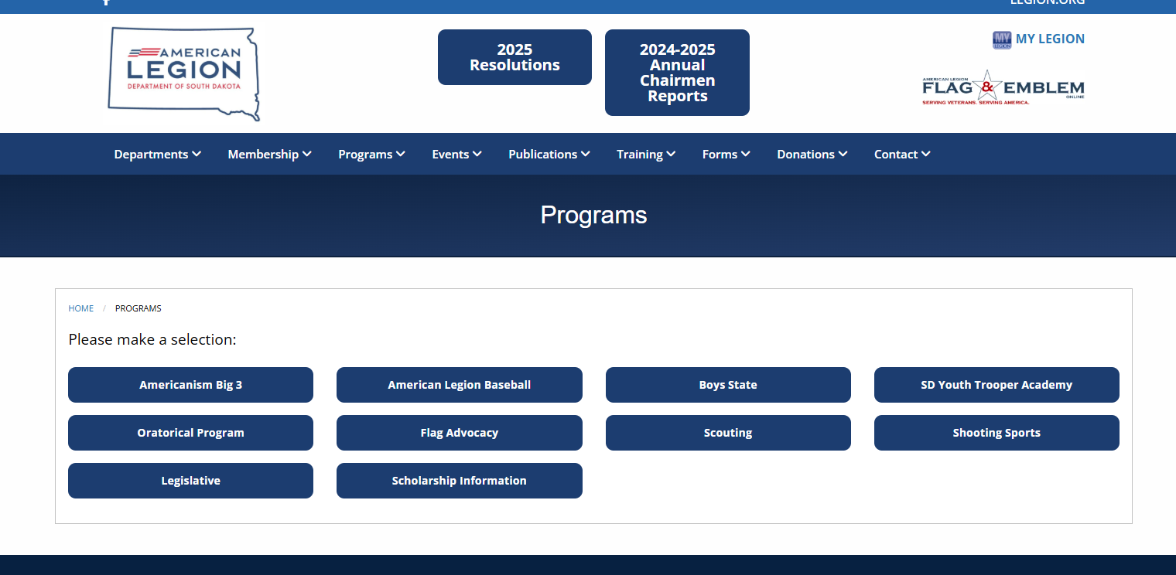

South Dakota Department
American Legion Legislative Committee
https:/sdlegion.org/programs

Slide 6

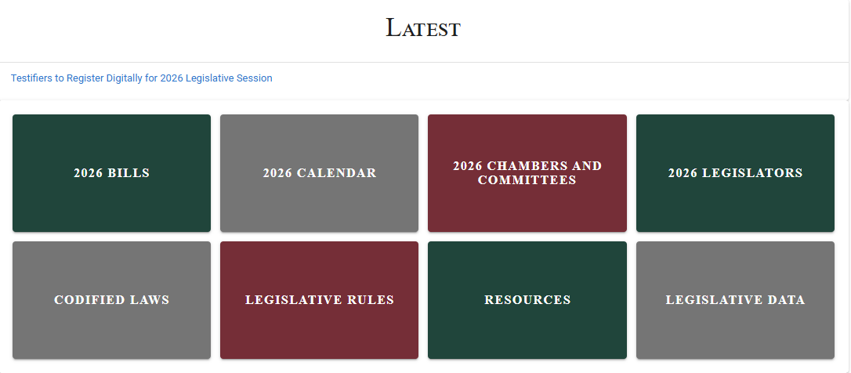
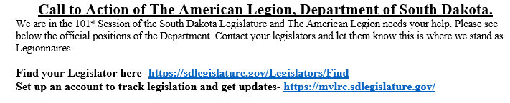
Home | South Dakota Legislature
https:/sdlegislature.gov/

Slide 7

Get Involved at the National Level
Purpose: The purpose of the Legislative Committee is to provide information and assistance to American Legion Auxiliary members to advocate for the legislative agenda of The American Legion. Standing Rule #5, National Committees – Mission Outreach
Utilize The American Legion’s Legislative Website at www.legion.org/legislativeto obtain information on legislative priorities, call for immediate action, and connect with representatives.
  Grassroots Action Center
  Sign up for alerts.
  Locate pending legislation.
  Contact your representatives.
  Report on meetings with representatives.
Host a Meet the Candidates Night. Invite all candidates involved in a specific election for a question-and-answer session, not a debate with a townhall format with no Legion Family signage.
https://member.legion-aux.org/Member/Committees/Legislative/How-to-Host-a-Meet-the-Candidate-Night
Promote the ALA Legislative Advocacy Guide to develop a plan to increase legislative awareness in your community.
https://member.legion-aux.org/Member/Guides/Advocacy-Guide
Join the Legislative Mini-Council to advocate for The American Legion Family’s legislative priorities with members of Congress with whom you have personal relationships.
Stay on top of upcoming legislative initiatives that may impact the efforts of Be the One and mental health awareness.
https://www.legion.org/betheone

Slide 8
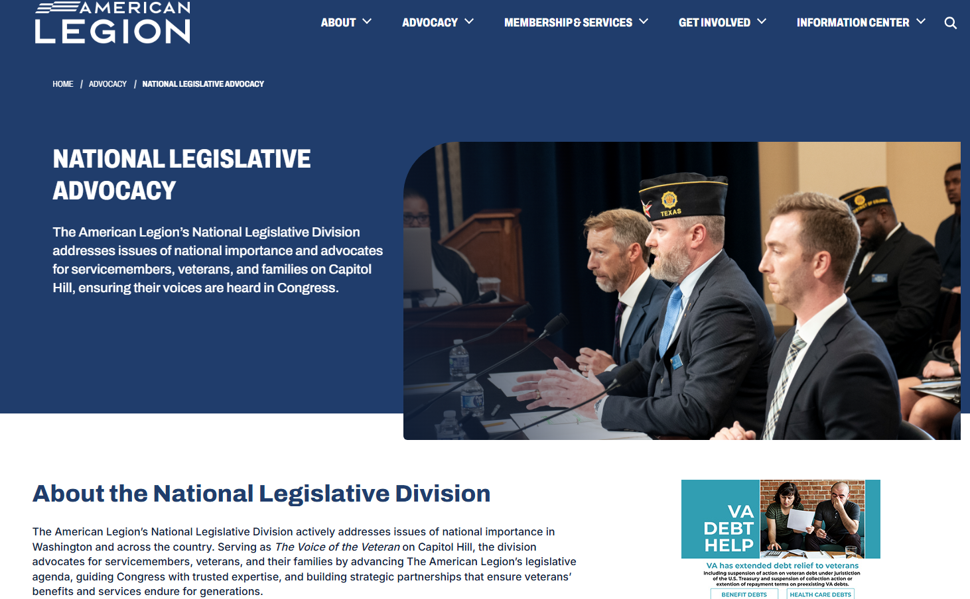
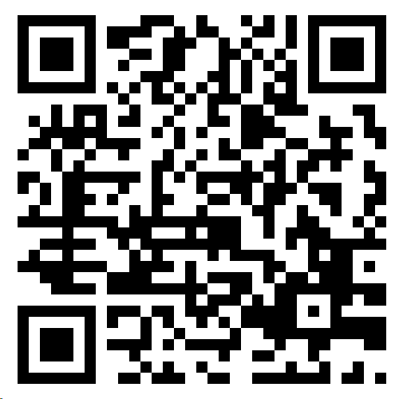
Topics on Legislative Division

Slide 9
Grassroots Action Center Components
Report Meeting
Sign Up for Alerts
Find Officials
Find Legislation

Slide 10
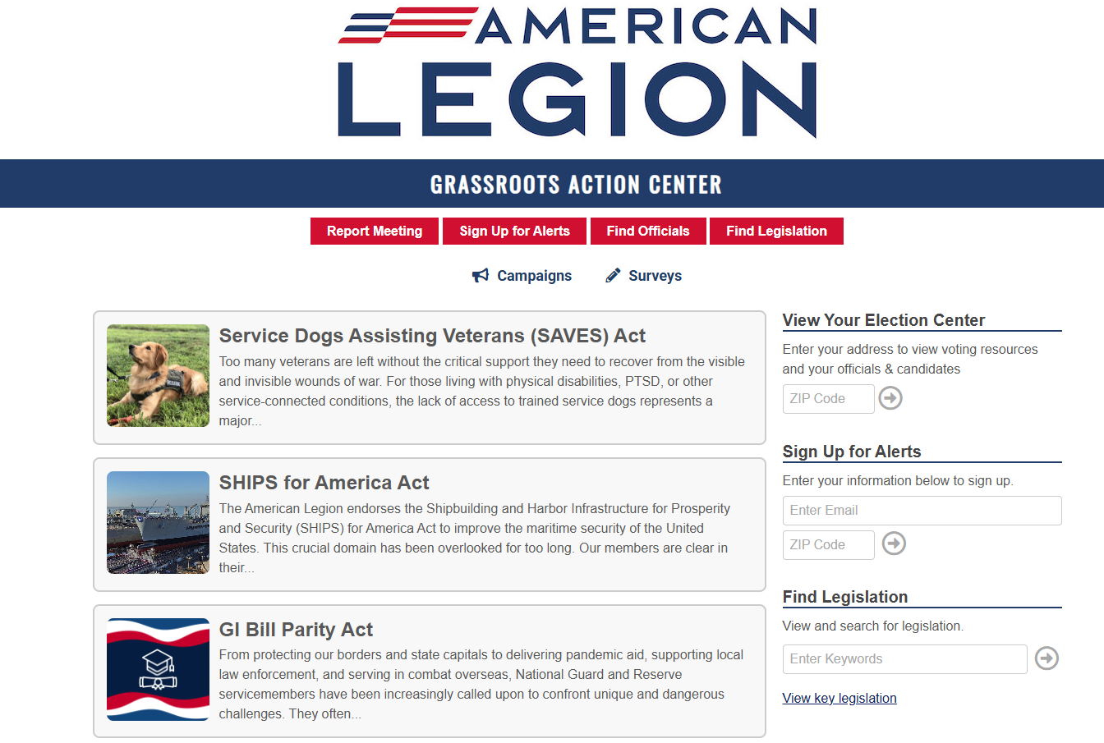
Grassroots Action Center
Grassroot Action Center
Complete & submit Congressional Contact Form
Sign up for legislative alerts to act
Locate officials using your zip code
Locate pending legislation and key Legion supported legislation by category

Slide 11
Grassroot Action Center
The Grassroots Action Center provides shortcuts to:
View Your Election Center
Sign Up for Alerts
Find Legislation

Slide 12

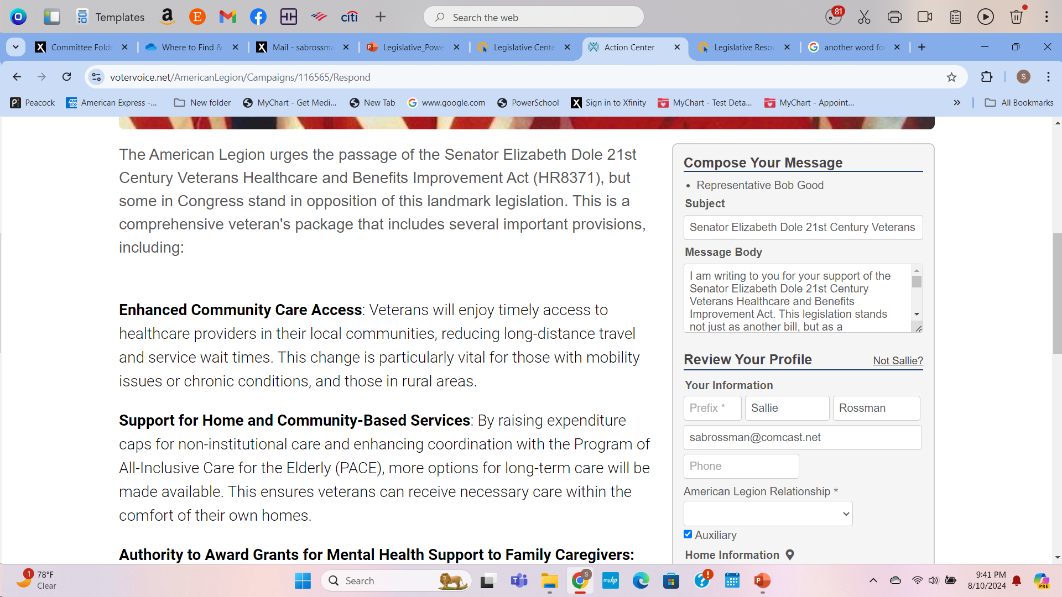
Grassroot Action Center
Compose Your Message
The Legion has standard messages for the legislation on their agenda. Click on the legislation you will compose a message.
These messages can be amended by a member before sending to your representative.
Review your profile before clicking “Send Message” or “Print”
Maintain a record of messages sent for year-end reporting.

Slide 13
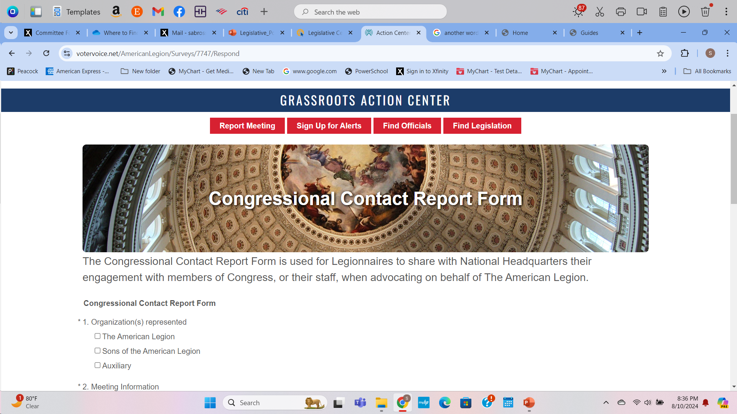
Report Meeting
American Legion Auxiliary Members

Slide 14
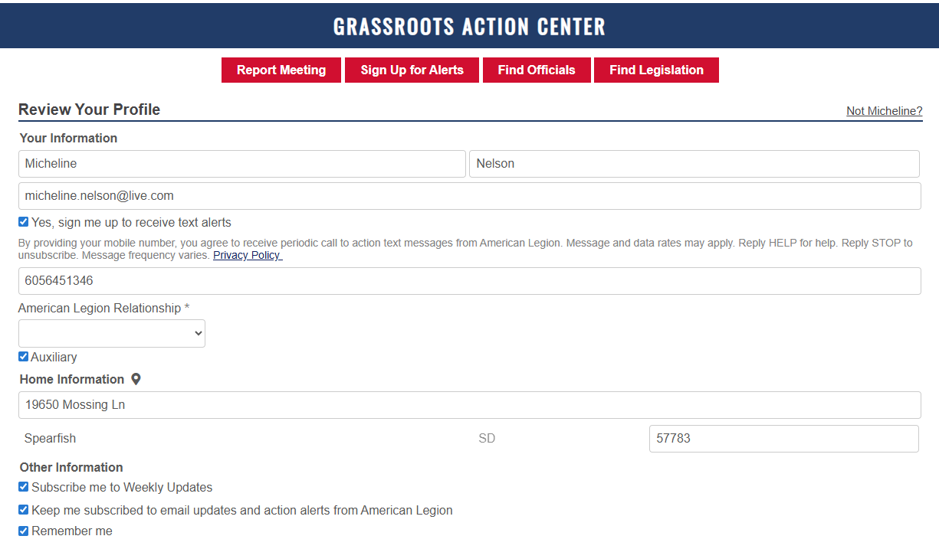
Sign Up for Alerts
Complete all sections
Check all the following to receive all alert information:
under “Other Information”
Subscribe me to Weekly Updates
Keep me subscribed to email updates and action alerts from American Legion
Remember me

Slide 15
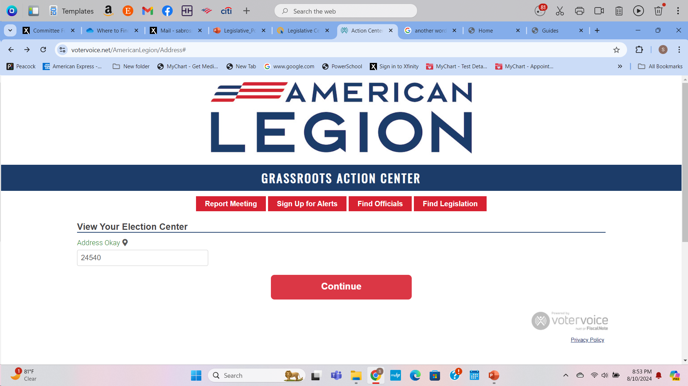
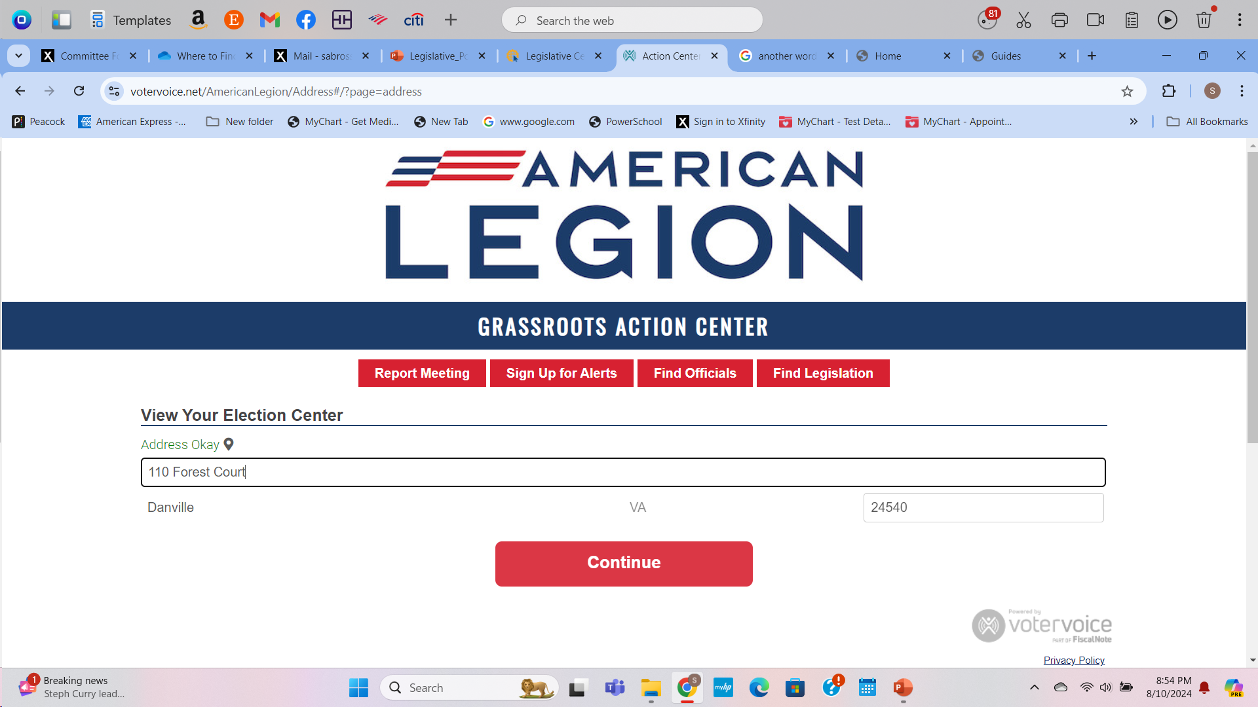
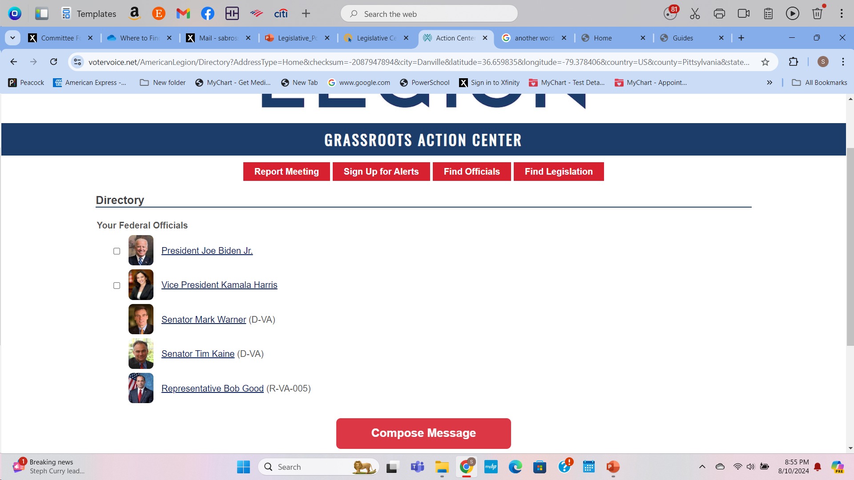
Find Officials
Enter zip code & click continue
Enter Street Address & click continue
Select officials to contact, click Compose Message, write message, & click send message.

Slide 16
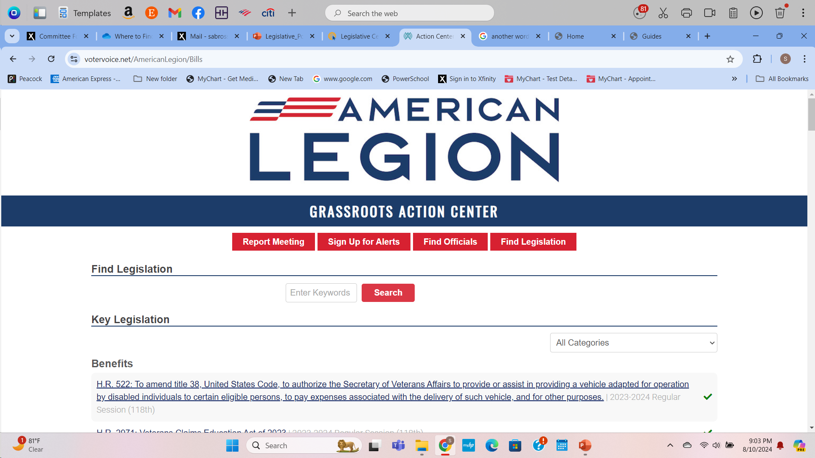
Find Legislation
Search for legislation by keyword
Search for legislation by category
Scroll through the Legion supported legislation. Click on the legislation to review.

Slide 17
Methods to Contact
Your Assigned Representative
Schedule a meeting
Congress is now open to visitors, meaning legislators and their staff may now physically meet with people. A 15- to 30-minute meeting with your legislator’s office will give you an opportunity to delve into a deeper conversation about the Legion’s Legislative Agenda.
Call your legislator
You may also call your representative’s office and ask to speak with the staffer who handles the veteran and/or military portfolio. You can also ask for an email address if a phone number is not provided.
Send an email
Congressional staff are closely monitoring office emails and will note the issues most prevalent in their district.

Slide 18
What You Should Speak About
Review The American Legion’s legislative priorities using the Legislative Agenda and the point papers. This will give you a clear understanding of the issues and The American Legion’s recommended solutions to the problem.
After the Meeting
Please be sure to fill out a congressional contact report form after you contact your congressional office. This will allow the national Legislative staff to know that the meeting took place and make staff members aware of any follow-up actions to take with the representative or their staff.

Slide 19
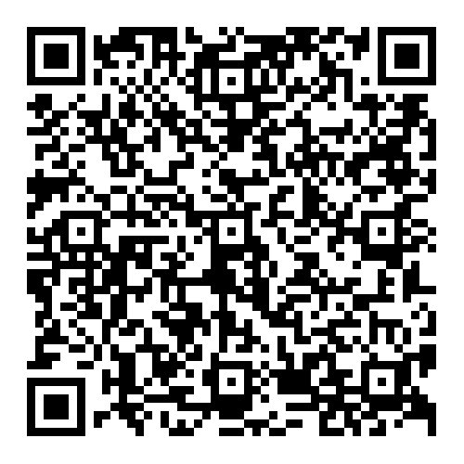

How to Host a
Meet the Candidates Night
Contact Information for Questions: legislative@ALAforVeterans.org
Encourage and empower members to be more knowledgeable to act on The American Legion’s legislative priorities.
Step-by-Step Instructions: A “meet the candidate” night is a question-and-answer session where all candidates for a specific election are invited to answer questions. It is not intended to be a debate.
Suggested Date of Event: 2-3 weeks before elections
https://member.legion-aux.org/Member/Committees/Legislative/How-to-Host-a-Meet-the-Candidate-Night

Slide 20
3 Months Prior to the Event
To make this a Legion Family event, work with your Legion post, SAL squadron and Riders chapter (if applicable) to form a planning committee. If this isn’t a Legion Family event, the unit Legislative chairman and unit president should appoint a planning committee. Identify a place, date and time for the event. Map out a plan to get the word out to the general community. Think about if you’ll serve refreshments; will they be donated, or do you need to buy them? Set guidelines for candidates before the event about literature, political signs and handouts.
  If the place is the post home, ensure you have approval for the space and it’s on the calendar. Determine if your post allows political material (like signs) to be displayed on post property
1. After the candidate filling deadline has passed, pull a list of candidates from your state's election board or Supervisor of Elections’ website. Prepare a spreadsheet of all ballot-ready candidates (local, state and/or federal) who will be invited. List their name, address, phone, email, party and office. Allow ample time to contact them and receive their response.
2.Mail and email invitation letters with Legion Family Point of Contact name and the deadline date to reply. Remember: The Legion Family is nonpartisan, so you need to invite ALL candidates. Follow up periodically with candidates who have not replied. Suggest to the candidate they send another representative if there is a conflict in their scheduling.

Slide 21
2 Months Prior
The planning committee arranges for volunteers for the following roles:
  Moderator (1) – Someone impartial and ideally not a part of the Legion Family, such as local news reporter or radio host or someone known and respected by the community. Using someone on TV or radio also ensures that it will be announced on TV/radio.
  Timekeeper (1) –To keep everyone on track. Each candidate should get an equal amount of time each round.
  Legion Family Ambassadors (Several)–To man a table on programs and services your Legion Family offers. They should also have membership applications on hand.
  Servers (Several) – Have a small team of volunteers serve refreshments.
  Crowd Control (Several) –Volunteers to ensure that no attendee gets out of control. (Legion Family Sergeants at Arms might be great for this role).
  Screeners (Several) - Volunteers to collect and review questions from attendees. Selected questions will be given to the moderator for a Q&A period. *Note: Candidates can stay after to talk with people and address their issues.
  Public Relations Coordinator (1)–Someone who will ensure that event is advertised in local newspapers, social media, websites and any other media outlet. They might invite a radio station or local TV station to stream the event live.(They might form a team to help promote the event on social media, create a hashtag, etc.).

Slide 22
2 Months Prior to the Event (continued)
2. The planning committee sets an agenda and how the event will proceed. Depending on the number of candidates in attendance, allow time for opening and closing speeches for each(this could be 2 to 3 minutes). After opening speeches and introductions, the moderator will ask for questions (that have been screened).
  If question is to a particular candidate, allow 1-2 minutes for the answer and allow opposing candidate the same amount of time. There should be no rebuttals!
  If it is a general question, the moderator can ask any candidate to address it, but again only 1-2 minutes per candidate.

Slide 23
Day of Event
Ensure there is no Legion Family signage and no branded apparel on members in the meeting room as the Legion Family is non-partisan.
Set up the room with the candidates in front of the audience.
Prepare tent cards for all candidates with their name, party and the office they’re seeking. You may wish to seat candidates alphabetically to not show favoritism.
Set up a table to talk about the programs and services your Legion Family offers. They should also have membership applications on hand and other Legion Family branded information.
Setup a table for voter registration¹. Members of your Americanism committee might be good to man this table, or you can invite an outside organization, like the League of Women Voters to help with the voter registration.
After the Event
Follow up with thank you notes to all the candidates who participated.
If media did not attend, work with your Public Relations chairman to send pictures to be published and posted on social media.

Slide 24
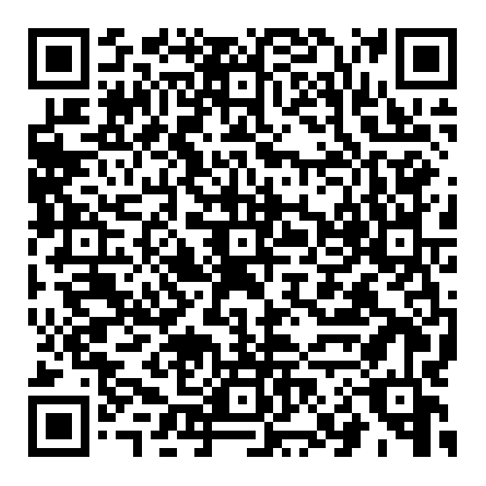


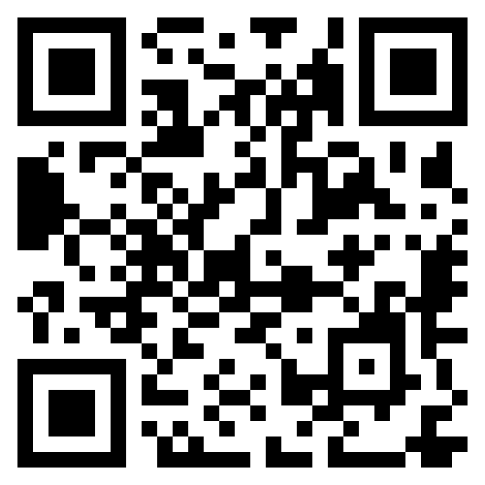
Legislative Key Resource QR Codes
https://member.legion-aux.org/member/committees/legislative
ALA Legislative Advocacy Guide
The American Legion Legislative website
The American Legion Dispatch

Slide 25
Legislation Annual Reporting Guidelines
Department chairs’ annual reports reflect the cumulative summary of units’ mission service in the department. Each department Legislative Committee chair is required to submit via email a narrative report to the division Legislative Committee chair, plus copy the national Legislative Committee chair by May 15.
The annual report is separate from the submission for national award consideration and impact number reporting. However, department reports may be taken into consideration for national awards.
Photos (in a high-resolution format) that show unit mission Legislative Committee activities accompany these reports.
April 15, 2026: Unit submit their written narrative report (answer as many questions as possible) and attach pictures. Preferably by email to micheline.nelson@live.com
Or mail to Micheline Nelson, 19650 Mossing Lane, Spearfish – SD 57783

Slide 26

Legislative Annual
Reporting Guidelines
Department Chairs’ Annual Reporting Guidelines:
Department chairs’ reports share the positive impact of our mission! They help us tell the world who we are, what we do, and why we matter. Just three simple steps are needed to add your part to our national success story:
Department reports are limited to 1,000 words.
Provide details/examples about the activity. Be sure to include specific information such as unit name and number.
Submit your department chair report to your division and national chair with photos by email by May 15. Find contact information here.
Photos should be in a high-resolution format (at least 300 DPI) or sent using the high-resolution option on your smartphone. When emailing the photo, select “actual size” for attaching to the email.
    When possible, include photos of actual events
    The request for photos is important for our national chairs to highlight members serving our mission.

Slide 27
Legislative Annual
Reporting Guidelines
As part of your narrative report, please include answers to the following questions:
How did units and the department promote the legislative agenda of The American Legion? What training did units and the department use to inform members of legislative priorities and the Grassroots Action Center on The American Legion’s legislative website?
What course of action did members, units, and the department use to advocate for The American Legion’s legislative agenda?
What legislative activities (town hall meetings, legislative receptions) did members attend and host in their communities, units, and the department? What suggestions did members have to improve those activities?
What avenues did members use to develop relationships with elected officials? Did members serve on the Legislative Council?
Please describe how members connected with their local, state, and national officials and their successes. How many members received a response from their officials and in what format?
These should be tied directly to the Program Engagement Plan (where applicable) or the Key Program Statements.

Slide 28
Legislative Program Awards
2025-2026 Legislative Program Awards Deadlines
and Submission Requirements
All award submissions must include a narrative (either a PDF or Microsoft Word document) explaining why the department or unit you’re nominating should receive the award. The narrative can also be the department chair’s report.
You may also upload other supporting documentation that will give the committee a full picture of the important mission work your department, or unit has accomplished this year. These files can be photos (JPG, JPEG or TIFs -- no larger than 14MB) or PDF documents. If you have more than three supporting files, please email the committee email address listed in the form.
National Awards Form Link: https://www.legion-aux.org/National-Awards-Form

Slide 29
Legislative Program Awards
Unit Award: Most Outstanding Unit Legislative Program (per division)
Presented: One unit in each division
Materials and guidelines:
  The narrative should not exceed 1,000 words and should include specific examples of how the unit delivered mission service. The narrative can also include portions from the department chair’s report.
  It should include action (high-resolution) photos, scans/links to news articles, etc.
  All unit entries must be submitted via electronic form by 5 p.m. EST on June 1.
Note: You will receive a confirmation when your award is submitted.
National Awards Form Link: https://www.legion-aux.org/National-Awards-Form

Slide 30
Legislative Program Awards
Department Award: Best Department Legislative Program (per division)
Presented to: One department in each division.
Materials and guidelines:
  The narrative should not exceed 1,000 words and should include program-related mission service; it may consist of the department chair’s report.
  Should include action (high-resolution) photos, scans/links to news articles, etc.
  All department entries must be submitted via electronic form by 5 p.m. EST on June 1.
Note: You will receive a confirmation when your award is submitted.
National Awards Form Link: https://www.legion-aux.org/National-Awards-Form

Slide 31
Legislative Program Awards
Photographs with youth (age below 18) have signed permission from parent(s) for publication.
Award submissions become property of the American Legion Auxiliary National Headquarters. Through submission of reports and award entries, the submitter grants nonexclusive reproduction and publication rights to the materials submitted and agrees to have their names and submission published for ALA use or commercial use without additional compensation or permission.
Please fill out the information as completely and accurately as possible. Award certificates will be completed using the information given on this sheet, so please be sure to complete the electronic form in its entirety.
Please refer to the webpage for the specific criteria such as photographs, narrative length, submission deadline, and point of contact. All awards will be mailed to the department office after ALA National Convention. Department presidents may wish to recognize award recipients by presenting them with the award at a department function.

Slide 32

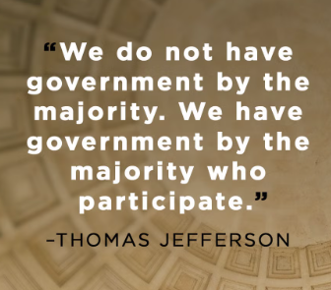
“The American Legion Auxiliary is that group of citizens whose involvement in the Legislative program which provides information and assistance to American Legion Auxiliary members to advocate for the Legion's legislative agenda. Awareness of The American Legion's priorities and call-to-action alerts prepares the Auxiliary to communicate with representatives on impending legislature. Using knowledge to persuade elected officials to achieve The American Legion's priorities is often the process of changing or reforming attitudes toward the needed legislature.”
Sallie Rossman, 2024-2025 National Legislative Chair

